Slide 1
Music Genre Classification using LSTM
Ml Batch 11:- team 191
Members:-1)Bharat Chhabil Dave
2)Vinayak Ganpatrao Chavan
3)Rutvik Sunil Bhalekar
4)Ajaykumar Lalchand Gupta

Slide 2
What we have done
Built a Neural Network Model to classify 10 different music genres
The project can divided into 3 parts
Data collection
Preprocessing
Building and training the neural network

Slide 3
Motivation
Why we need music genre classification
A huge amount of music on the Internet
People are more likely to browse or search music by genre
Why choosing this topic
Machine learning is the hotest topic recently
Less studied than others types of media

Slide 4
Dataset
GTZAN Genre Collection (by George Tzanetakis)
Typically representative of the styles of that genre
 | Duration | Number of Genre | Number of soundtrack | Format
GTZAN data set | 30 Seconds | 10 | 100/genre | 22050Hz Mono 16bit audio file in wave format
Genre: Classic, Hip-hop, Jazz, Metal, Pop, Reggae, blues, Rock, Country Folk, Disco

Slide 5
Music sample
Hiphop | hiphop_001.au | Jazz | .au
Metal | .au | Blues | .au
Pop | .au | Country Folk | .au
Reggae | .au | Disco | .au
Rock | .au | Classic | .au
Notes:
Add the music sample later click and then will play the corresponding music

Slide 6
Mel-Frequency Cepstral Coefficient(MFCC)
Represent sound by approximate human auditory system
MFCC (Mel-frequency cepstrum) popular for Speech recognition
Also used in Music genre classification and Similarity measurement

Slide 7
Extracted Feature
 | Features
Typical Number of MFCCs | 13

Slide 8
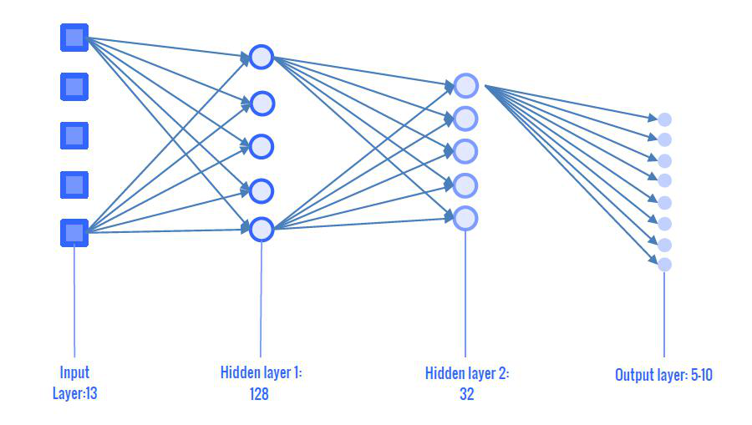
Our LSTM model
2 LSTM layer with density of 128 and 32
Output : 10 genres(one-hot)
Notes:
I will draw a better picture for the model later

Slide 9
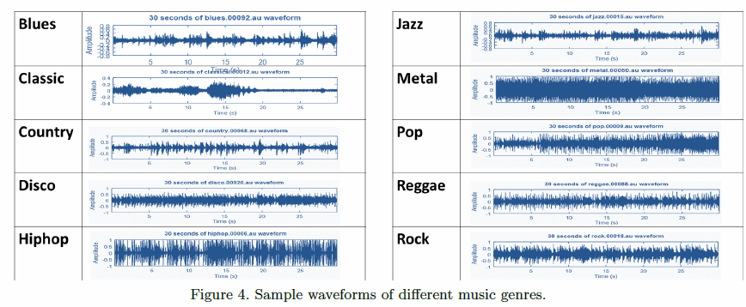
10 different genres

Slide 10
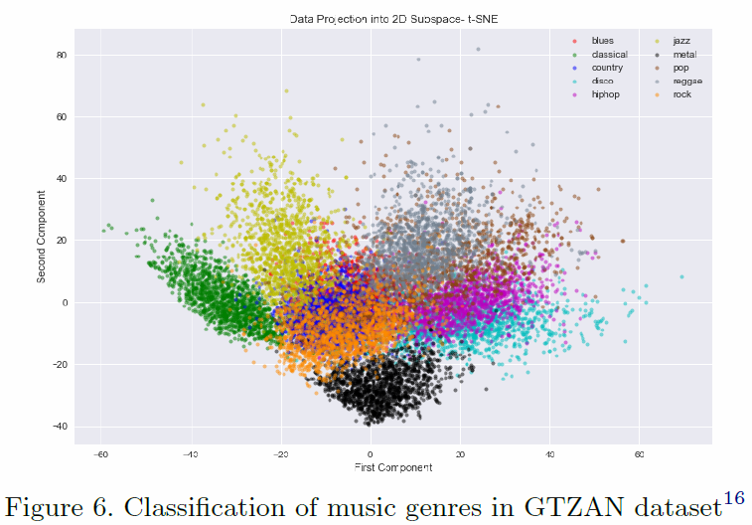
Classification of music genres in GTZAN dataset

Slide 11
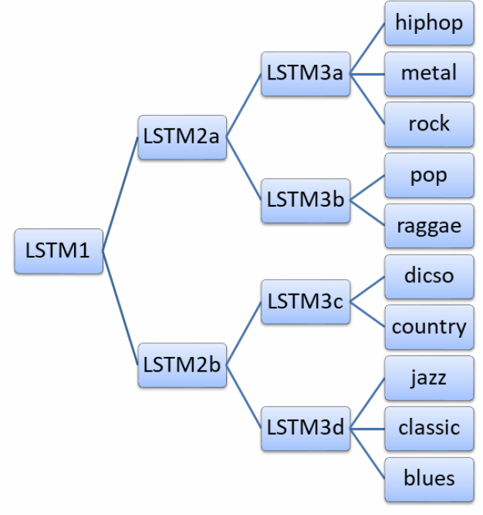
7 LSTM(Divide and Conquer)
 | Input | Output | To
LSTM1 | 750(All in training set) | strong or mild | 2a,2b
LSTM2a | 375(Strong) | strong 1 or 2 | 3a,3b
LSTM2b | 375(Mild) | mild 1 or 2 | 3c,3d

Slide 12
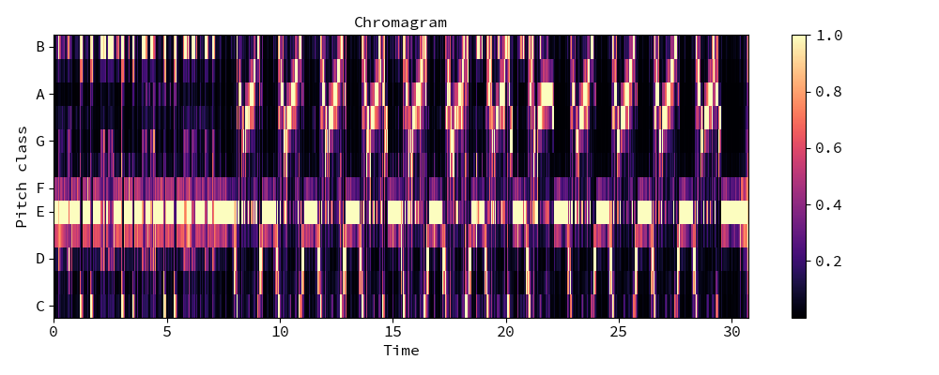
Chroma features
Represent a music audio into 12 distinct semitones of the musical octave

Slide 13
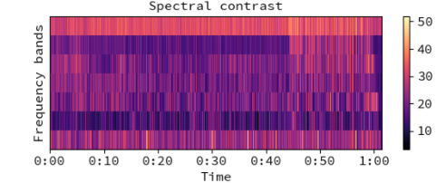
Spectral Contrast
Provide better performance than MFCC in music genre classification
the spectral contrast is calculated as the difference between the maximum and minimum magnitudes in the spectrum

Slide 14
Conclusion
Developed a 10 music Genres classification system.
Accuracy is 50% which is comparable to the state-of-that resulsts.

